Slide 1
Programming with C and Python For Newbies
Day 11: Logic gates ,nested loops and conditional statements & Functions

Slide 2
Logic Gates
AND – two of the arguments must be True
OR – atleast one of the arguments must be True
NOT – argument must be False

Slide 3
Nested conditional statements and loops
There are some operations which requires us to check some conditions at every given time or iterate over it more than once. So we used nested if statements or loops to do such operations .

Slide 4
Function
A function is a block of reusable code that performs a specific task. It helps us to organize our code more better and easier to understand.
A function allows us to:
Break up codes into modules
Suppress detail
Create new primitives

Slide 5
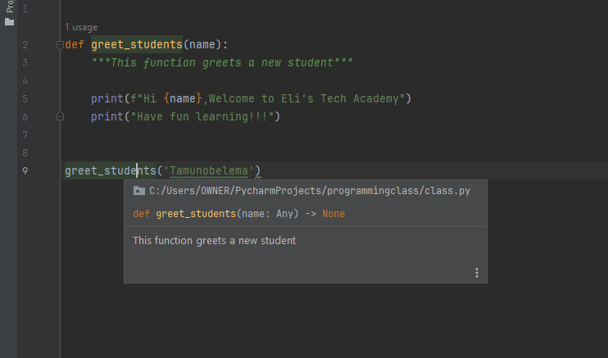
Declaring a function

